Slide 1
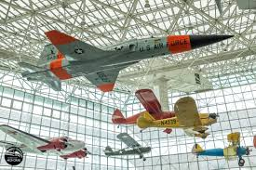
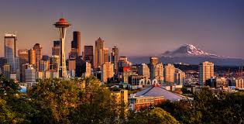
Next Meeting
1-3 November, 2017
Embassy Suites, Tukwila (Seattle) WA

